Slide 1


DTI Atlas fiber analyzer
Tutorial
Berger Jean-Baptiste
jean-baptiste.berger@cpe.fr

Slide 2

Index
Introduction - - - - - - - - - - - - - - - - - - - - - - - - - - - - - - - - - - - - - - - - - - - 3
Step1: Select your Data - - - - - - - - - - - - - - - - - - - - - - - - - - - - - - - - - - - 6
Step 2 : Atlas Settings - - - - - - - - - - - - - - - - - - - - - - - - - - - - - - - - - - - - 13
Step 3 : Analysis Settings - - - - - - - - - - - - - - - - - - - - - - - - - - - - - - - - - - 20
Step 4 : Plot Window - - - - - - - - - - - - - - - - - - - - - - - - - - - - - - - - - - - - 27
Additional Information - - - - - - - - - - - - - - - - - - - - - - - - - - - - - - - - - - - 35
Merging Statistic With Fiber Data - - - - - - - - - - - - - - - - - - - - - - 36
Output Hierarchy - - - - - - - - - - - - - - - - - - - - - - - - - - - - - - - - 40
Automated Required Information Filling - - - - - - - - - - - - - - - - - 42
Contributors - - - - - - - - - - - - - - - - - - - - - - - - - - - - - - - - - - - - - - - - - 46

Slide 3
Introduction

Slide 4
Introduction
Main Goals
Statistical analysis of fibers for different cases
Visualization of those statistics
After statisticians processing, merging of statistics with fibers
Visualization on Slicer

Slide 5
Introduction
Pipeline
DTIAFA
Generate Statistics
Plot Statistics
Statistician
Clean up statistics
MergeStat
Merge statistics with fibers
Viewable on slicer

Slide 6
Step 1 : Select your
Data

Slide 7
Select your Data
In this step, you will specify the data which you want to analyze
Basically, you will specify a .NRRD file and optionally a Deformation Field
From those files, information will be mapped with an Atlas Fiber

Slide 8
Select your Data
There are 2 different ways to select relevant data :
  Manually thanks to this tools help
  Automatically by opening a data file through the file menu on the top of the window – For more information see “Automated required filling information” beginning at slide 36

Slide 9
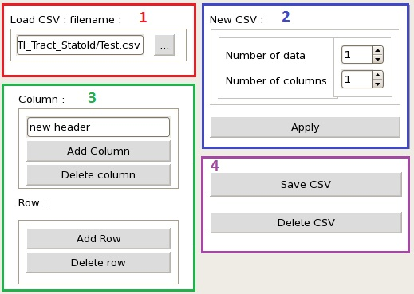
Select your Data
Define a CSV File
1- Load an existing .csv file using the browser “…” button
Or
2- Create a new empty table by choosing the number of row and column
3- Modify the current .csv file
You can add a row or a column for the next Id. Or delete a selected row or a selected column
4- Finally Save or Delete the current table

Slide 10
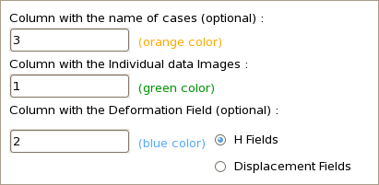
Select your Data
Define each column
Select the type of data that will contains each column
When you enter a number the associated column will be colored as follow :
  Orange for optional
  case names
  Green for Data
  Blue for optional Deformation Fields
Select whether you will be using h-fields or displacement fields as deformation fields

Slide 11

Select your Data
Fill the Table
Double click on a Data Cell to open a browser and select an image file (.nhdr or .nrrd)
Double click on a Deformation Cell to open a browser if you want to add a deformation field
To specify a case name just enter a name in the “Name” column

Slide 12
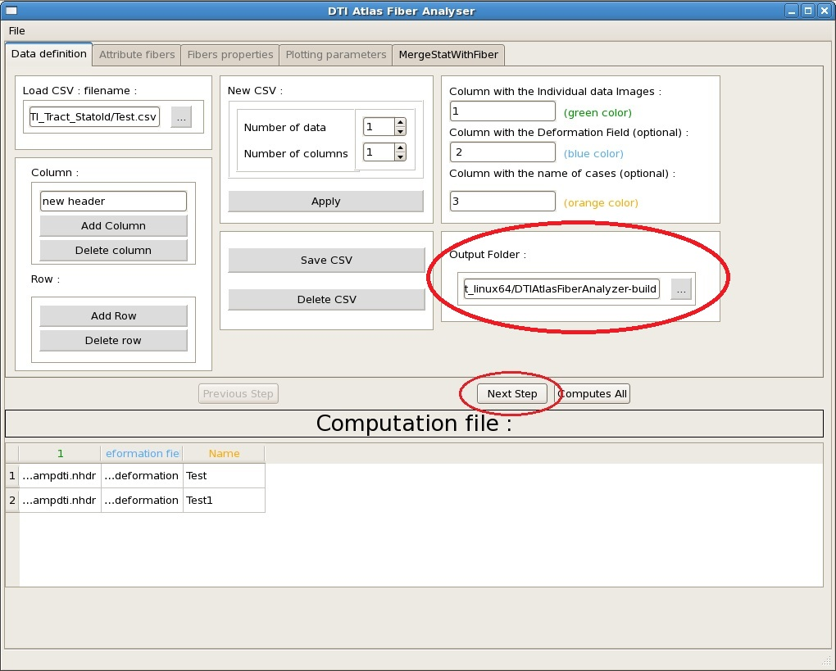
Select your Data
Going to Step 2
To go to the next step you need to specify an output folder (see Output Hierarchy for more information)
If there are :
  A Table
  A data column specified
  An output folder
Then you can click on “Next Step” to go to the Step 2

Slide 13
Step 2 : Atlas Settings

Slide 14
Atlas Settings
Here you will choose which Atlas Fiber you want to map your data with
This step will extract the fiber from the input image
Then statistical information could be extracted

Slide 15

Atlas Settings
Specify the Atlas Folder
Click on “…” button to open the browser
Specify the path to your Atlas Folder
This tool only support VTK Files or FIB Files

Slide 16
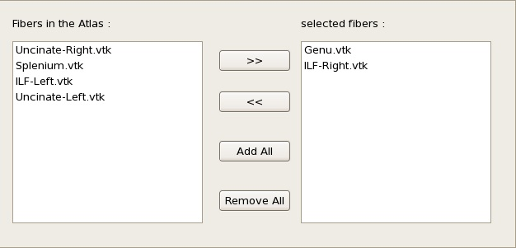
Atlas Settings
Select Fibers to use
On the left part you can see every Fibers File read on the Atlas Folder
The right part contains the fibers that you chose to continue the analysis
Click on a fiber to select it
Use “>>” or “<<“ buttons to send a selected item to the right or left part.
“Add All” and “Remove All” will send every fibers from the left to the right and vice versa

Slide 17
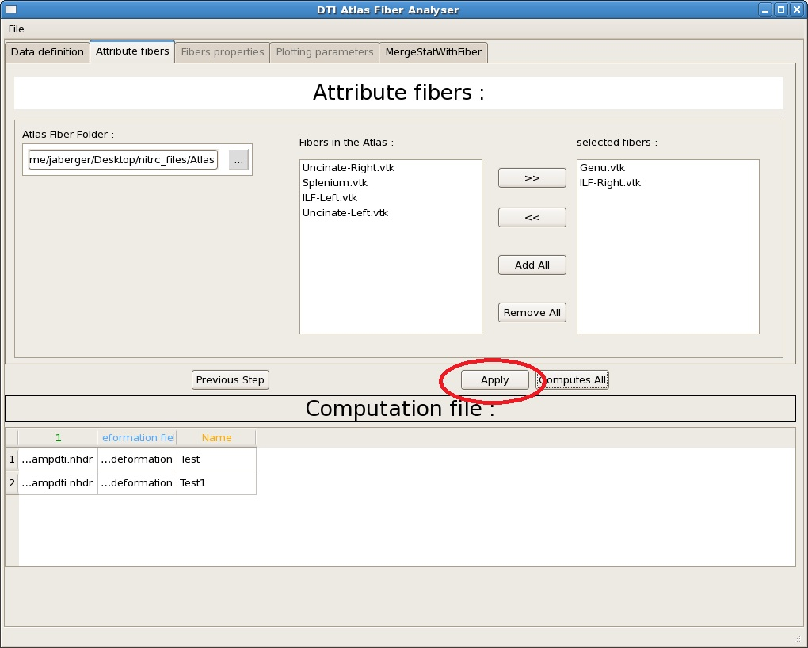

Atlas Settings
Extract Fiber From Volume
If there is at least one fiber selected, you can click on “Apply”
“Apply” will process data for each cases and for each selected fibers
It will create a VTK File for each combination case-fiber named as following : casename_fibername.vtk
You can see created file on the Table

Slide 18
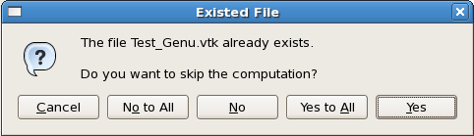
Atlas Settings
Skipping computation?
If a file already exist in the same folder (see Output Hierarchy) a window pop up
“Cancel” will stop FiberProcess
“No” and “No to All” will replace the existing file by the computed one(s)
“Yes” and “Yes to All” will use the existing file(s) for the following steps

Slide 19
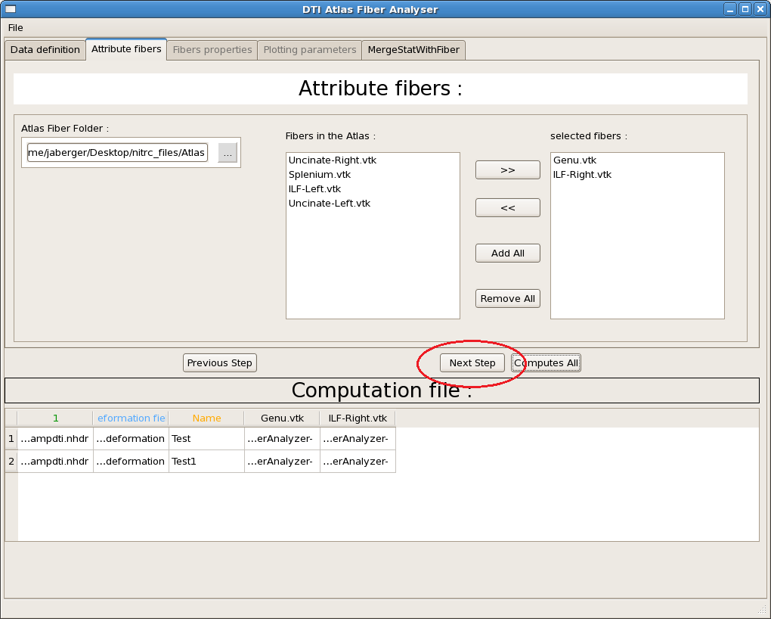
Atlas Settings
Going to Step 3
If processing went right, “Next Step” button will replace the “Apply” button
Clicking on “Next Step” will send you to Step 3

Slide 20
Step 3 : Analysis Settings

Slide 21
Analysis Settings
  In this step you will read statistical information from the previous extracted fiber
  An initialization will be done thanks to a plan file
  All those information will be gathered in one data sheet per cases
  Besides cases, those information will also be extracted from the Atlas Fiber to allow you to compare both files from case and atlas

Slide 22
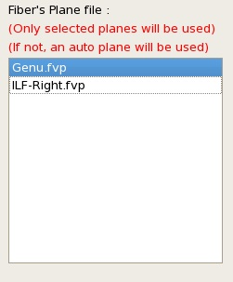
Analysis Settings
Select planes
Listed planes are FVP File read in the atlas directory
Click to select or deselect a plane file
A plane file should contains the name of the fiber to be read
If no plane file is selected for a fiber, the tool will use an auto plane setting

Slide 23
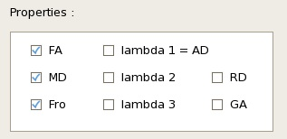
Analysis Settings
Select parameters
Select which parameters you want to compute
At least one parameter needs to be checked

Slide 24

Analysis Settings
Select summary reports layout
Gathered information (CSV Format) will be written as follow :
  If you select “Arc length : row”, one data sample will correspond to one line and one case for one column
  If you select “Case : row”, the table will be transposed

Slide 25

Analysis Settings
Select auto plane settings
This option will define the origin point of an auto plane
If “Center of Gravity” is checked, the origin will be the center of gravity of the whole fiber bundle
If “Median point on Fiber” is checked, the origin will be the median point on the fiber
The normal is always the direction between the two closest point to the origin

Slide 26

Analysis Settings
Calculating Statistics
As in Step 2, click on the “Apply” button to calculate statistics and gathered information on a CSV File
It will calculate statistics for each file created on Step 2
One FVP File per call will be created and added in the Table plus one per fiber that will describe the atlas
Gathered informations files are created as follow :
  One file per fiber per parameter is created
  Each file is named : fibername_parameter.csv
When computation is finished, the “Next Step” button will replace the “Apply” button
Click on “Next Step” to go to the Step 4

Slide 27
Step 4 : Plot Window

Slide 28
Plot Window
This step helps you to compare statistical information by plotting them
3 types of curves can be distinguished : curves from cases, from atlas and statistical values such as mean and std
You also will be able to check the correlation mapping between each cases and the atlas

Slide 29
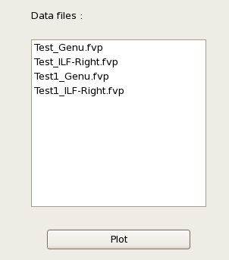
Plot Window
Pop up the Plot Window
The list shows which files will be plotted
Only FVP Files can be read
Click on “Plot” to open the plot window that will display each relevant curves

Slide 30
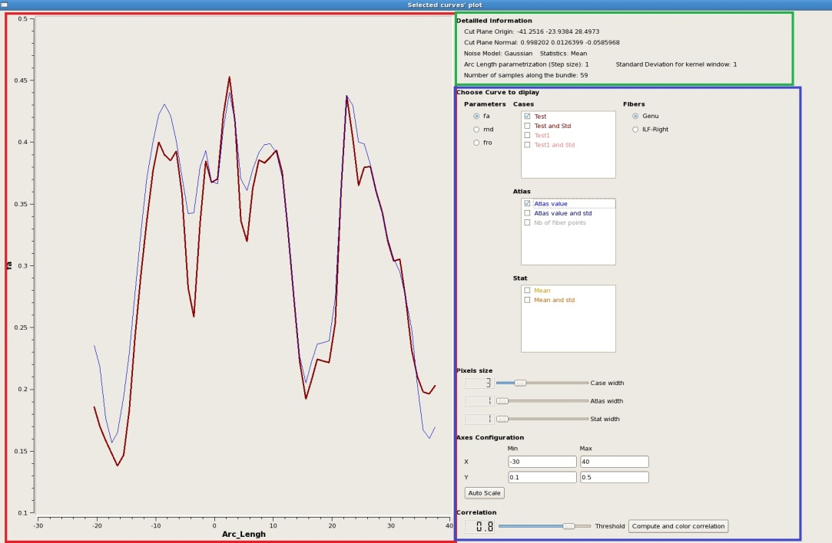
Plot Window
Window structure
Plot Interface : Checked curves will be displayed here. Three kind of curves can be displayed :
  Cases
  Atlas
  Statistic
Detailed information of the FVP File read
Option panel to change the display

Slide 31
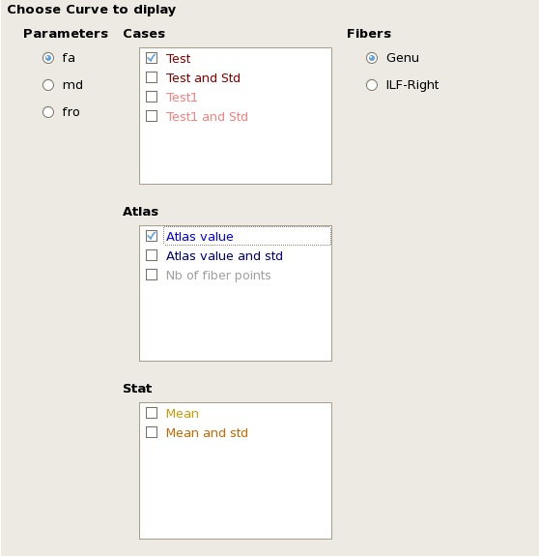
Plot Window
Selecting displayed curves
Choose which parameter to display for each curves
Then, Check a box corresponding to a case to display the associated curve
Choose the fiber you want to display
Just one parameter and one fiber can be selected at a time
Standard deviation curves are plotted with discontinue dashes

Slide 32
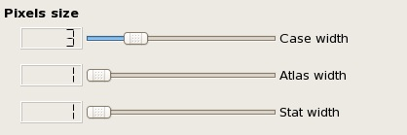
Plot Window
Adapting pixel size
Use Sliders to change the pixel size for each type of curves
Pixel width “1” is set as default

Slide 33
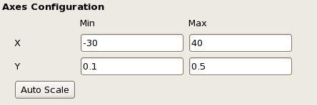
Plot Window
Configure axes scales
This is where you can set the axis scales
The Plot will be updated each time you finished entering a number
Click on “Auto Scale” button to auto set the values depending on plotted curves

Slide 34

Plot Window
Get correlation coefficients
Each Case curves have a correlation coefficient with the Atlas curve
If the correlation between a curve and the atlas is below the correlation threshold this curve will be colored in red
Colors on curves correspond to colors on case names
Click on “Correlation check mapping” to display all of the correlation coefficients and color each curves depending on the coefficient : (Light grey for 1 and black for 0)

Slide 35
Additional Information

Slide 36
Merging Statistic With Fiber Data

Slide 37
Merge Stat With Fiber
This tool will use a data sheet to merge data in the original .vtk file of a fiber
This will allow you to display each parameter value distribution in Slicer
For instance, you will be able to see the ‘Fa’ distribution as a color map on the fiber

Slide 38
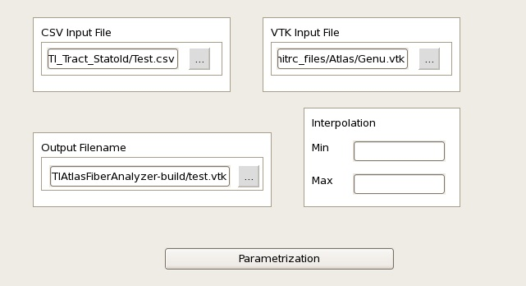
Merge Stat With Fiber
Specifying arguments
Choose a CSV File containing data samples to merge
Choose a VTK File for the data samples to be merged with
Specify the name of the VTK Output File
Choose Min and Max values of the linear interpolation that will computes Slicer data

Slide 39
Merge Stat With Fiber
Calling MergeStatWithFiber
Required fields:
  CSV Input File
  VTK Input File
  Output Filename
Optional field : Interpolation values
Click on Parametrization and the result will be written on the Output Filename

Slide 40
Output Hierarchy

Slide 41
Output Hierarchy
Output Folder/
  Cases/
  /CaseNames → Here will be stored Cases VTK Files and Statistics FVP Files for associated Case named : casename_fibername.vtk or .fvp
  Fibers/ → Here will be stored Statistics from Atlas VTK File for associated Fiber named : fibername.fvp
  FiberProfiles/
  FiberNames → Here will be stored gathered information for associated parameter named : parametername_fibername.csv

Slide 42
Automated Required Information Filling

Slide 43
Automated Required Information Filling
There is two types of information files :
  Data File : This one will fill information required for the first step such as the CSV File name
  Analysis File : This one will fill information required for Step 2 and Step 3 such as desired parameters
The global structure is :
  A beginning line
  List of Key : Value
You can add commentaries by beginning a line by “#”
Listed values should be separated with a coma
A default Analysis File will be created at the tool first use. Feel free to modify it since it will be loaded automatically for next uses. This default file located in the Output Folder is called : Default_Analysis_Parameters.txt
Use the file menu to Save or Load those different files

Slide 44
Automated Required Information Filling
Writing a Data File
The first line must be : “Data parameters for DTIAtlasFiberAnalyzer :”
Then, you can specify each of the following (Order doesn’t matter) :
  “CSVFile : ” + Path to the CSV File name
  “Data Column : “, “Deformation Field Column : “ or “Case Column : “ + number of the designated column
  “Field Type : “ + “h-field” or “displacement field” describing the deformation fields you will be using
  “Output Folder : “ + Path to the chosen output folder name
Example :
  Data parameters for DTIAtlasFiberAnalyzer :
  CSVFile : /path/to/CSV/File.csv
  Data Column : 1
  Deformation Field Column : 2
  Field Type : displacement field
  Case Column : 3
  Output Folder : /path/to/Output/Folder

Slide 45
Automated Required Information Filling
Writing an Analysis File
The first line must be : “Analysis parameters for DTIAtlasFiberAnalyzer :”
Then, you can specify each of the following (Order doesn’t matter) :
  “Atlas Fiber Folder : ” + Path to the Atlas Folder
  “Selected Fibers : “ + Name of each Fiber Files (in the Atlas Folder)
  “Selected Planes : “ + Name of each Plane Files (in the Atlas Folder)
  “Profile parameter : “ + Name of each Parameters
  “Col and Row : “ + Either “Case in row” or “Case in col” to transpose or not the gathered information table
  “Auto Plane Origin : “ + Either “median” or “gravity”
Example :
  Analysis parameters for DTIAtlasFiberAnalyzer :
  Atlas Fiber Folder : /path/to/Atlas/Folder
  Selected Fibers : Genu.vtk, ILF-Right.vtk
  Selected Planes : Genu.fvp
  Profile parameter : fa,md,fro
  Col and Row : Case in row
  Auto Plane Origin : median

Slide 46
Contributors
Jean-Baptiste Berger :
  jean-baptiste.berger@cpe.fr
Benjamin Yvernault :
benjamin.yvernault@cpe.fr
Yundi Shi :
yundiuu@gmail.com
Clement Vachet :
cvachet@unc.edu
Martin Styner :
martin_styner@ieee.org

